Slide 1

Early Detection of Mental Health Crises Using A Transformer Architecture
CSC 396 Programming Project
FALL 2025
Haocheng Cao, Kyle Dervin, Rena Wang

Slide 2
Problem & Motivation
Problem: Online posts often contain signals of emotional distress, depression, or suicidal intent that are hard to detect at scale
High-impact context: Platforms like Reddit serve as informal support spaces where users, and especially teens, express mental health struggles that may not be recognizable in-person
Motivation for automation: Identifying high-risk posts early can facilitate timely support and crisis intervention
Broader significance: Improving detection systems contributes to safer online communities

Slide 3
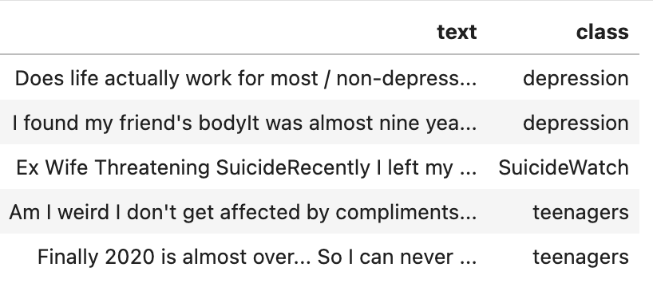
Data Source & Observations
Kaggle’s “Suicide and Depression Detection” Dataset
Three labels / classes: the associated text for each class comes from a subreddit with the same name
Balanced labels: ~116k posts per class
Labels
“SuicideWatch” -> posts that express suicidal ideation, crisis, or urgent distress
“depression” -> posts that describe depressive symptoms, hopelessness, or emotional pain
“teenagers” -> posts referencing adolescence, school life, and general teen issues

Slide 4
Data Limitations & Challenges
Limited open-access mental health data: Ethical constraints and privacy concerns make it difficult to find high-quality, publicly available datasets
Subreddit-based labeling is imperfect: Labels depend on the subreddit where the post was made and not necessarily the writer’s actual mental state
Heavy overlap in emotional language: Posts in ”SuicideWatch” and “depression” often express similar distress, making the boundaries between the labels blurry
Teenager posts use exaggerated language: Adolescents may be overly dramatic, increasing noise in the “teenagers” class, and reducing signal clarity

Slide 5
Baseline TF-IDF MODEL
“I feel hopeless and depressed today, depressed about everything”
“Term Frequency-Inverse Document Frequency”
- Maps words into numerical feature vectors
Process:
- Create vocabulary of 20,00 most common unigrams and bigrams (single words & word pairings)
- Assign a numerical vector to each word / word pairing
- Words that are frequent in a specific post, but not common across all posts get the highest weight
Idea:
- Give more weight to words like “depressed” that appear only in higher-risk posts and less weight to filler words like “the”
i
and
hopeless
feel
today
depressed
about

Slide 6
DistilBERT model
Goal: Improve performance over baseline by capturing context and long-range dependencies in text
Model: pre-trained DistilBERT adapted for sequence classification with classification head modified to output 3 logits (for the 3 labels)
Tokenization: Used DistilBertTokenizerFast with truncation and padding
Training:
- 3 epochs over the dataset
- Linear learning rate schedule (warm-up + decay)
- Adam optimizer with weight decay

Slide 7
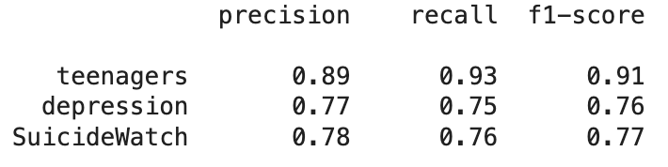
Baseline Results By label
Teenagers
Performs the best by a significant margin
High recall likely due to the distinctive lexical cues in this class, such as references to school, parents, age, friends, or homework
Depression
Worst performance
The emotional language is broad and varied (e.g., “sad”, “empty”, “can’t get out of bed”), and without deeper contextual understanding, this model struggles to distinguish depressive symptoms from general distress or crisis language
SuicideWatch
Crisis posts often contain subtle expressions of suicidal ideation (e.g., “I don’t want to be here anymore”), which may not include explicit keywords.
Without contextual modeling, TF-IDF often confuses subtle crisis language with severe depressive language

Slide 8
Results Comparison
Performance gains: Accuracy increased from 82% → 86%, Macro-F1 from 0.81 → 0.86, with corresponding improvements in Macro-Recall (+0.04) and Macro-Precision (+0.05)
Transformer improvements: Better at distinguishing SuicideWatch vs depression, understanding long narrative posts, and handling ambiguous teenager posts
DistilBERT advantage: Captures semantic relationships across posts, detecting subtle crisis indicators, emotional escalation, and implicit suicidal ideation
Model | Accuracy | Macro Precision | Macro Recall | Macro F1
Baseline | 0.82 | 0.81 | 0.82 | 0.81
DistilBERT | 0.8604 | 0.8604 | 0.8604 | 0.8604

Slide 9
ERROR ANALysis: Common themes
SuicideWatch labeled as depression
Many crisis posts express depression without explicit suicidal keywords
Teenagers labeled as depression
A lot of figurative expressions can be misclassified as depression.
Label noise
Some posts from “teenagers” subreddit discuss serious mental health issues, making the label ambiguous

Slide 10
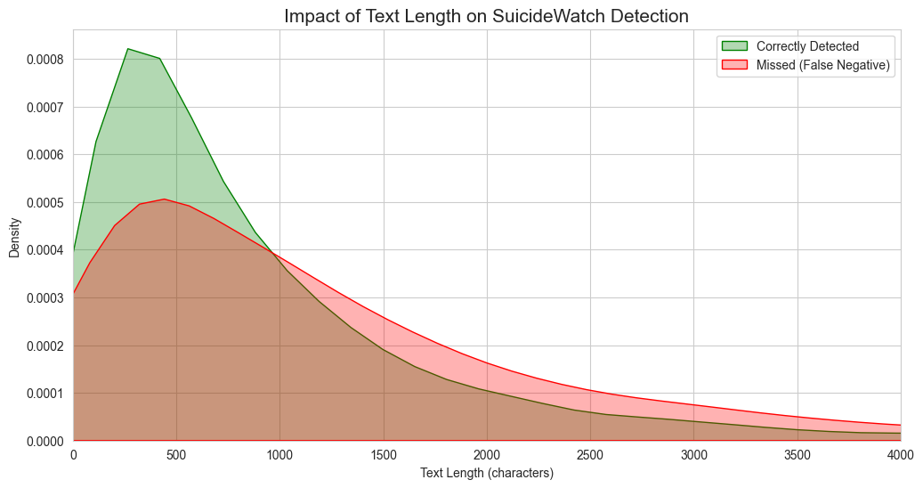
Error analysis: long text truncation
The 128 Token Problem
Efficient for training
Missing suicidal intent that's always at the end -> misclassification
Longer posts in KDE plot -> higher false negative rate
Explicit suicidal intent always appears after the truncation cut

Slide 11
Example 1
Correct Label: SuicideWatch
Predicted: depression
This post uses positive or neutral language at the beginning, which is very misleading
The only part that hints the suicidal ideation is the last part: “I couldn’t”, but it doesn’t show a strong tone which is that transformer relies heavily on.
“I'm ready!Haha yay! ...
Please be happy. I hope joy and success for you. I wish you get through the hard days. I couldn't."

Slide 12
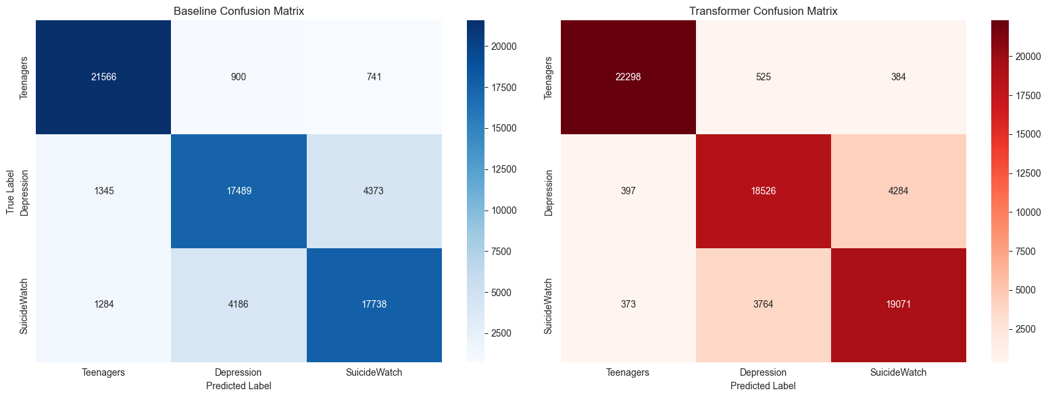
ERROR ANALysis: semantic overlap
Depression vs. SuicideWatch
Both share similar vocabulary
Many posts only have one line of suicidal intent.
When the intent is subtle or implicit:
  Model predicts depression, not SuicideWatch.
Confusion matrix shows heavy crossover between these two classes.

Slide 13
Error analysis: Label noise
Subreddit Labels ≠ Clinical Labels
Some “depression” posts contain explicit suicide plans.
Some “SuicideWatch” posts contain only general sadness.
Teenagers subreddit includes serious mental health discussions.
Model often “misclassifies” posts where:
  The content contradicts the assigned subreddit label
Sometimes reflect bad ground truth, not model weakness.

Slide 14
Example 2
Correct Label: teenagers
Predicted: depression
For a human being, this is for sure a joke written in sarcastical language, but for the model, the only thing they would capture is the high-risk emotional deterioration because of the "crying for help" at the end
Also, the writing style doesn't resemble typical teenager, as there are keywords like "marriage" and "kids”
This is an example of an inconsistent and noisy example
"I am cripplingly addicted to custard Edit: r/custard wouldn't take me so I come here for salvation.
… This is a cry for help.
Please
Save me."

Slide 15
Team Member Contributions and pitch
Kyle: Preprocessing the dataset and setting up the repo
Haocheng: Implementing the baseline and transformer models and gathering results
Rena: Error analysis and organizing thoughts for the project report and presentation
All equal work for the slidedeck
"Marketing pitch," i.e., why do you think you've done a good job?
Tackling a real, high-impact problem
Combination of classical ML and cutting-edge transformers
Detailed and efficient implementation
Strong performance – 86% macro-F1
Deep Error Analysis

Slide 16
Thank you!

